Slide 1

Understanding the Software Development Life Cycle (SDLC)
A comprehensive guide to structured software development processes, methodologies, and best practices for building robust applications.

Slide 2
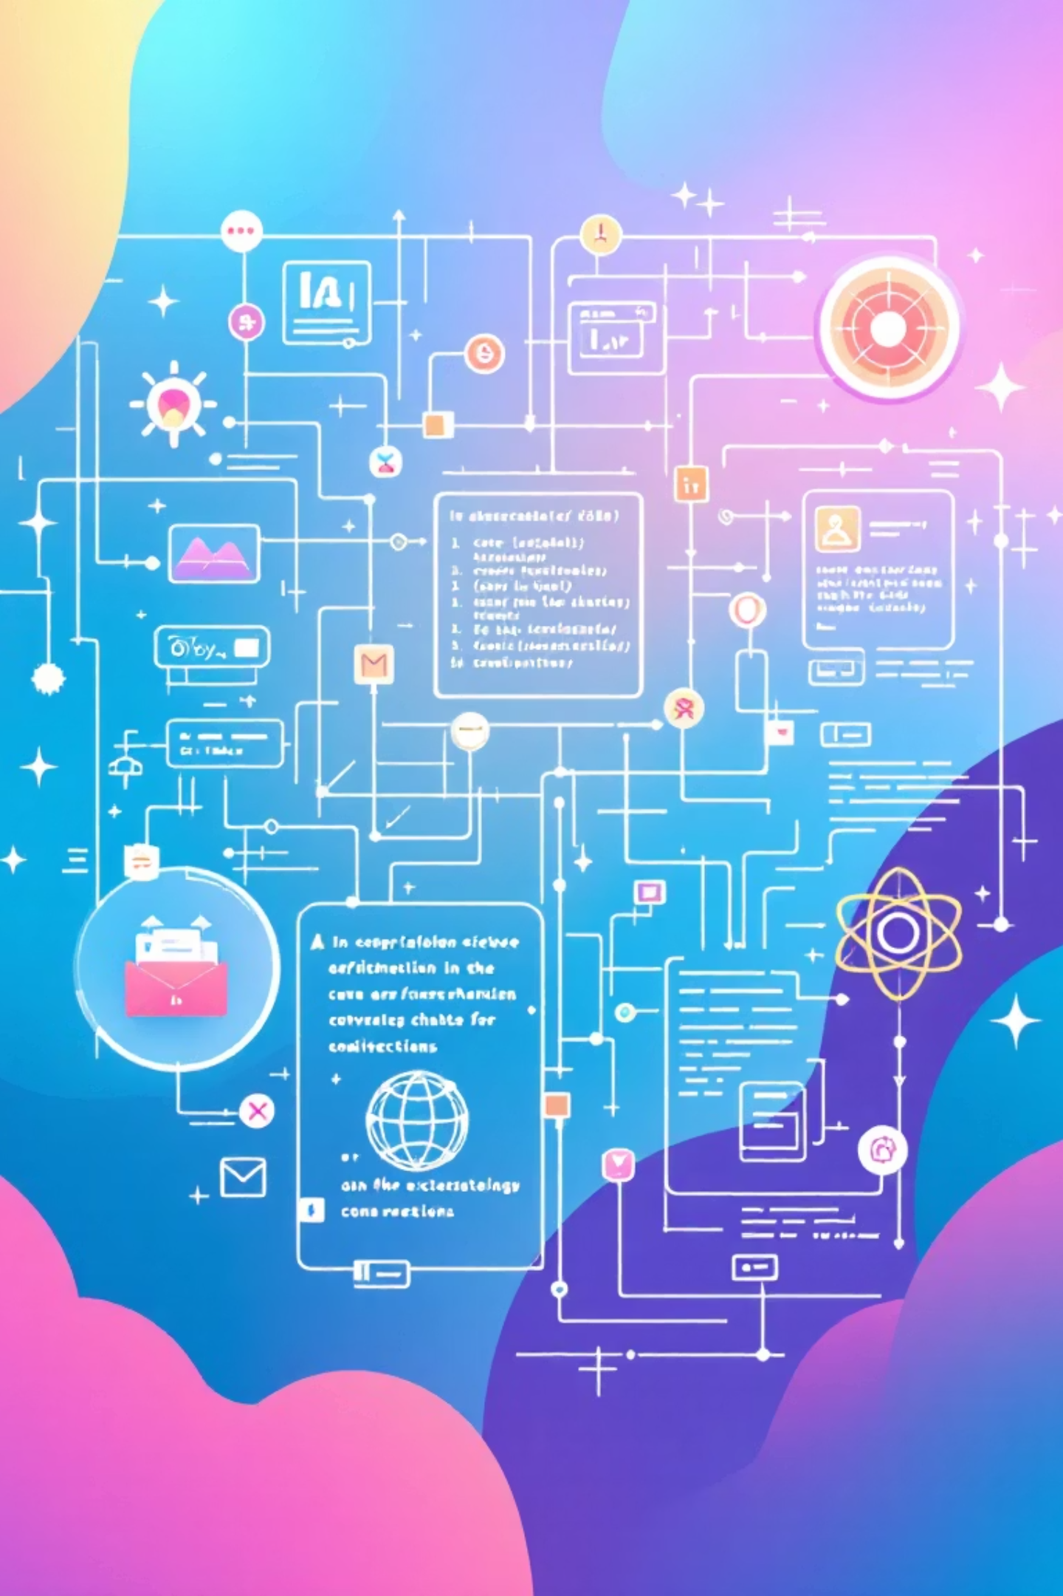
Why SDLC Matters: Building Software Right, Every Time
Structured Process
Risk Minimization
SDLC provides a systematic approach to design, build, test, and maintain high-quality software with clear phases and deliverables.
Controls costs, reduces project delays, and ensures software meets user needs and business objectives effectively.
Quality Assurance
Without SDLC, projects face significant risks including budget overruns, timeline delays, and subpar software quality.

Slide 3












The 6 Core Phases of SDLC
Planning
Design
Define project goals, gather comprehensive requirements, estimate costs and create realistic schedules.
Architect system structure, select appropriate technologies, and create detailed technical blueprints.
Maintenance
Implementation
Continuously monitor performance, fix issues, and implement updates to keep software current.
Developers write clean, maintainable code following established design specifications and coding standards.
Deployment
Testing
Safely move software to production environment, making it accessible to end users.
Execute automated and manual tests to identify bugs, ensure quality, and validate functionality.

Slide 4
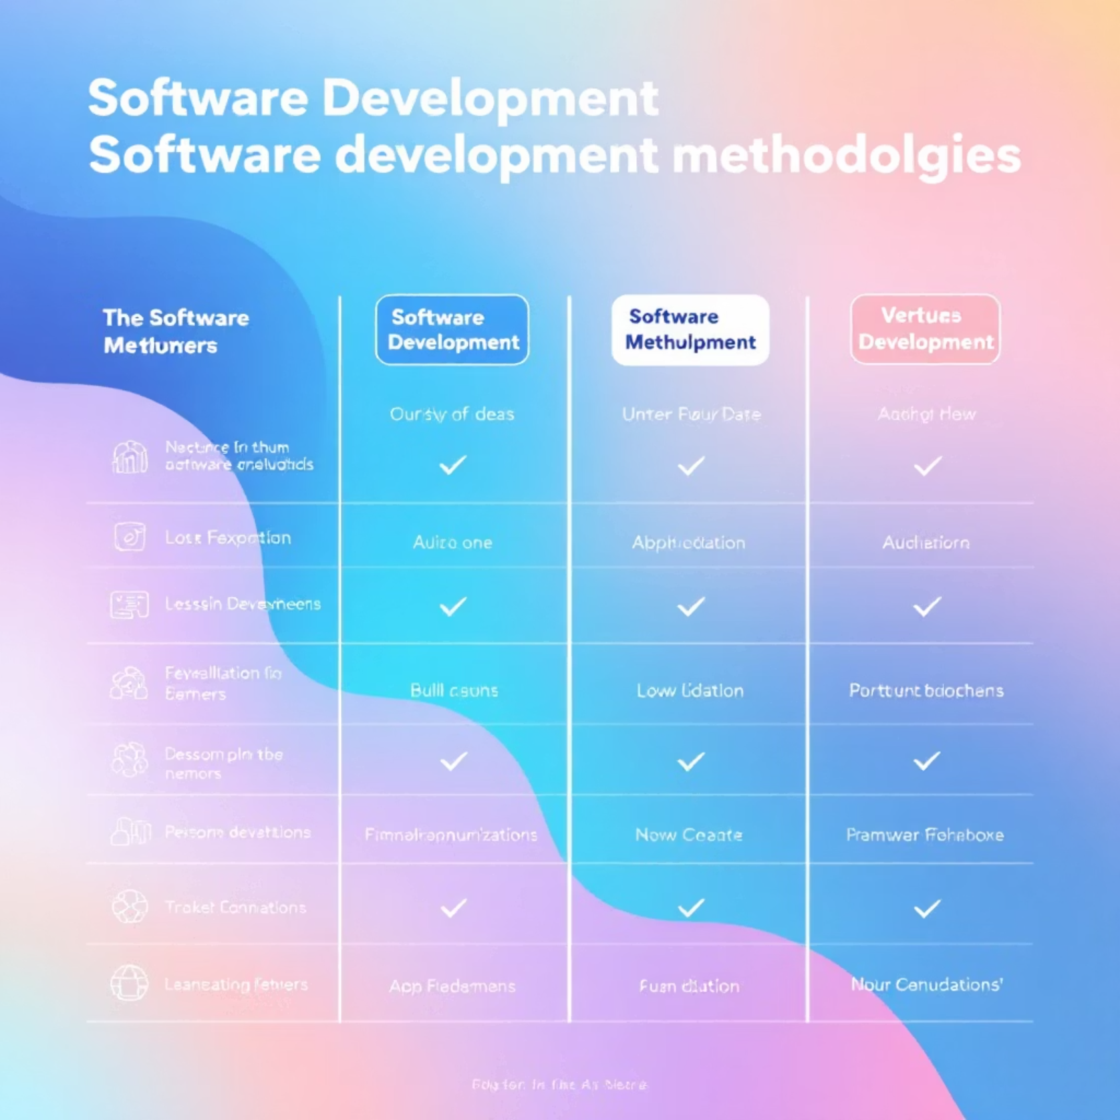
SDLC Models Overview: Choosing the Right Path
Model Selection Matters
Different projects require different SDLC models to effectively balance flexibility, risk management, and development speed.
We'll explore four popular methodologies: Waterfall, Agile, Spiral, and V-Model.
Each offers unique advantages for specific project types and team structures.

Slide 5
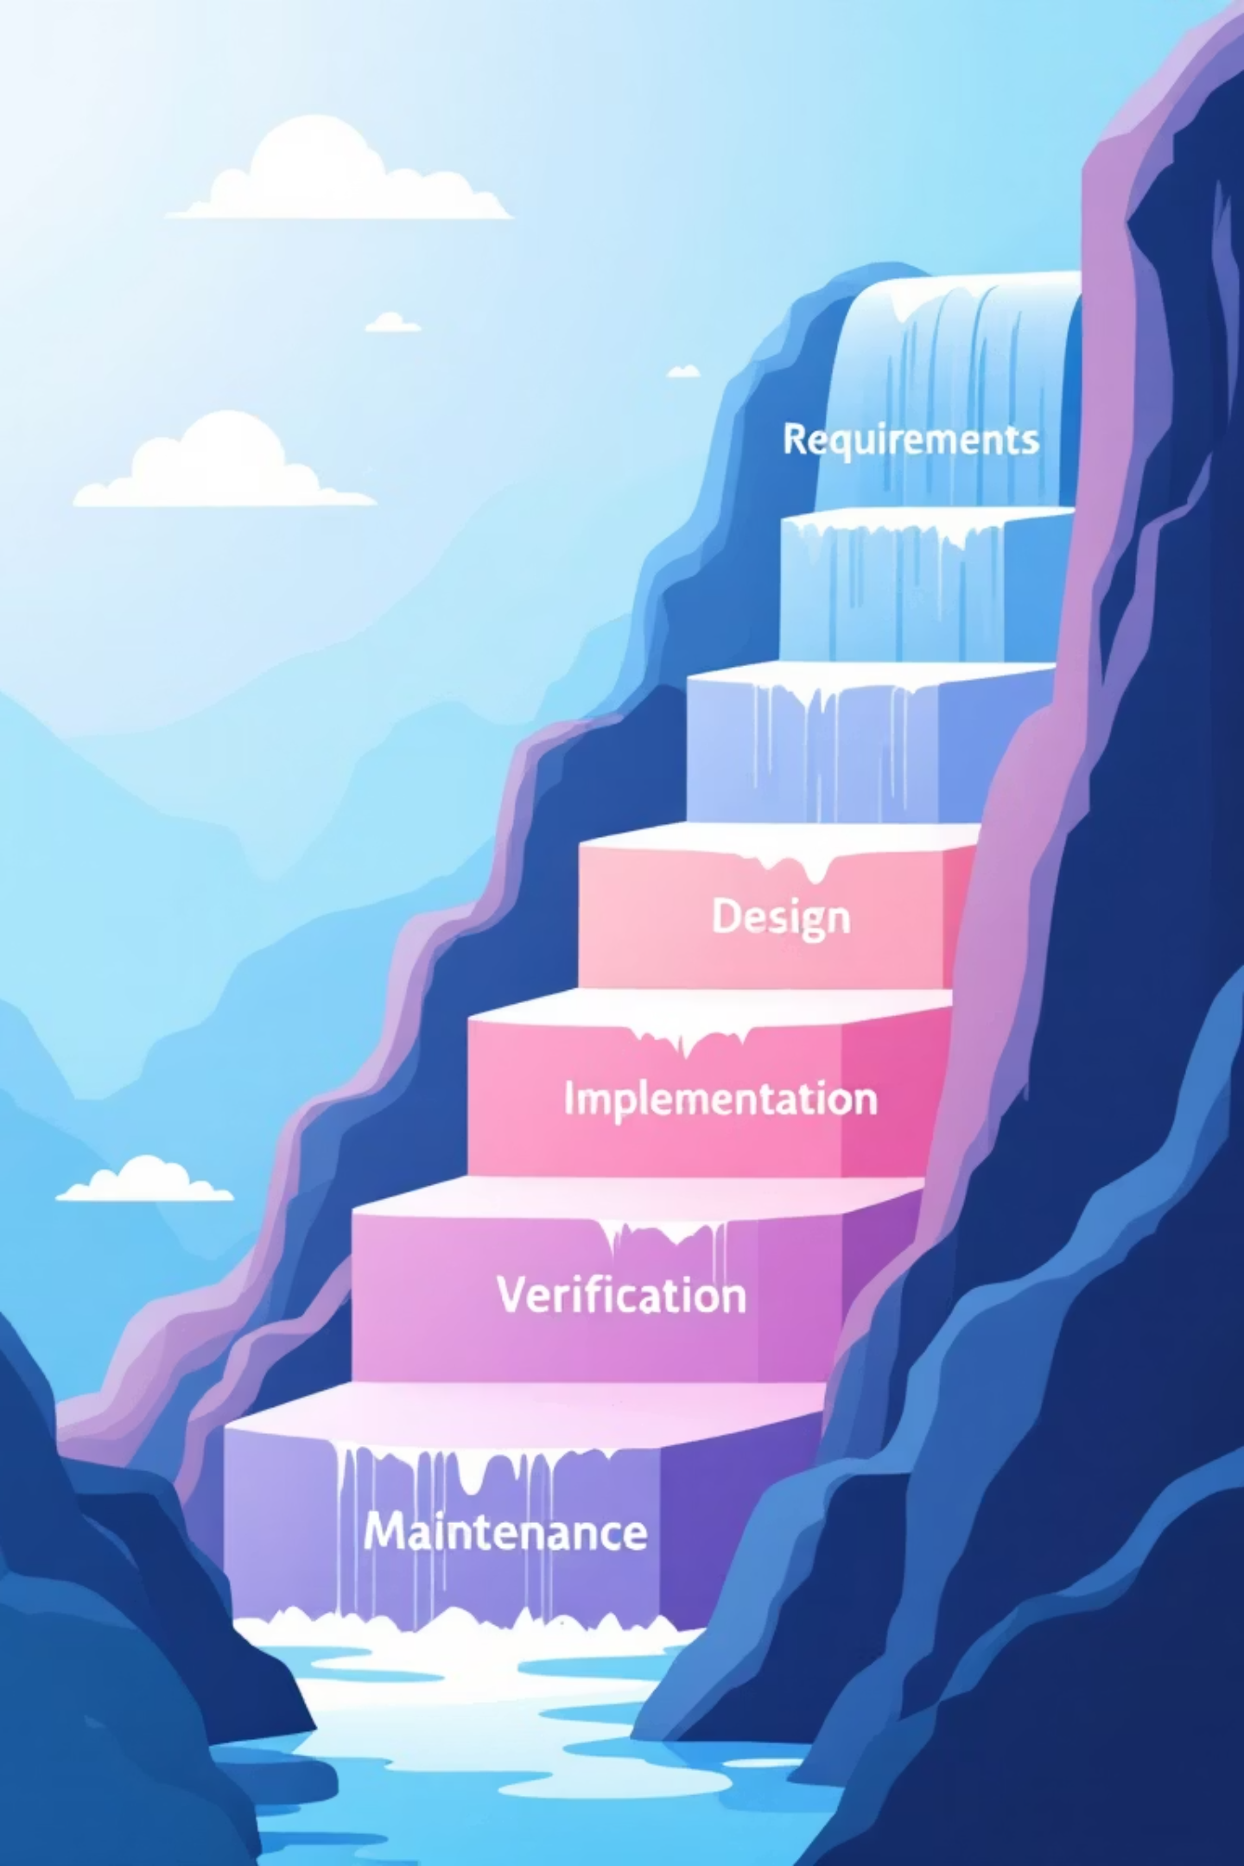



Waterfall Model: The Classic Linear Approach
Sequential Process
Each phase must complete entirely before the next phase begins, creating a clear linear progression.
Pros & Cons
Pros: Simple management, clear milestones
Cons: Inflexible, late testing, costly changes
Real-World Use
Ideal for government contracts and construction software with fixed, well-defined requirements.

Slide 6





Agile Model: Embracing Change and Collaboration
Iterative Sprints
Short development cycles with continuous feedback and frequent software delivery to users.
Key Benefits
Highly flexible approach, rapid releases, and strong customer involvement throughout development.
Challenges
Requires experienced teams and offers less predictability in scope and timeline management.
Industry Leaders
Spotify and Microsoft leverage Agile methodologies to rapidly innovate and adapt to market changes.

Slide 7
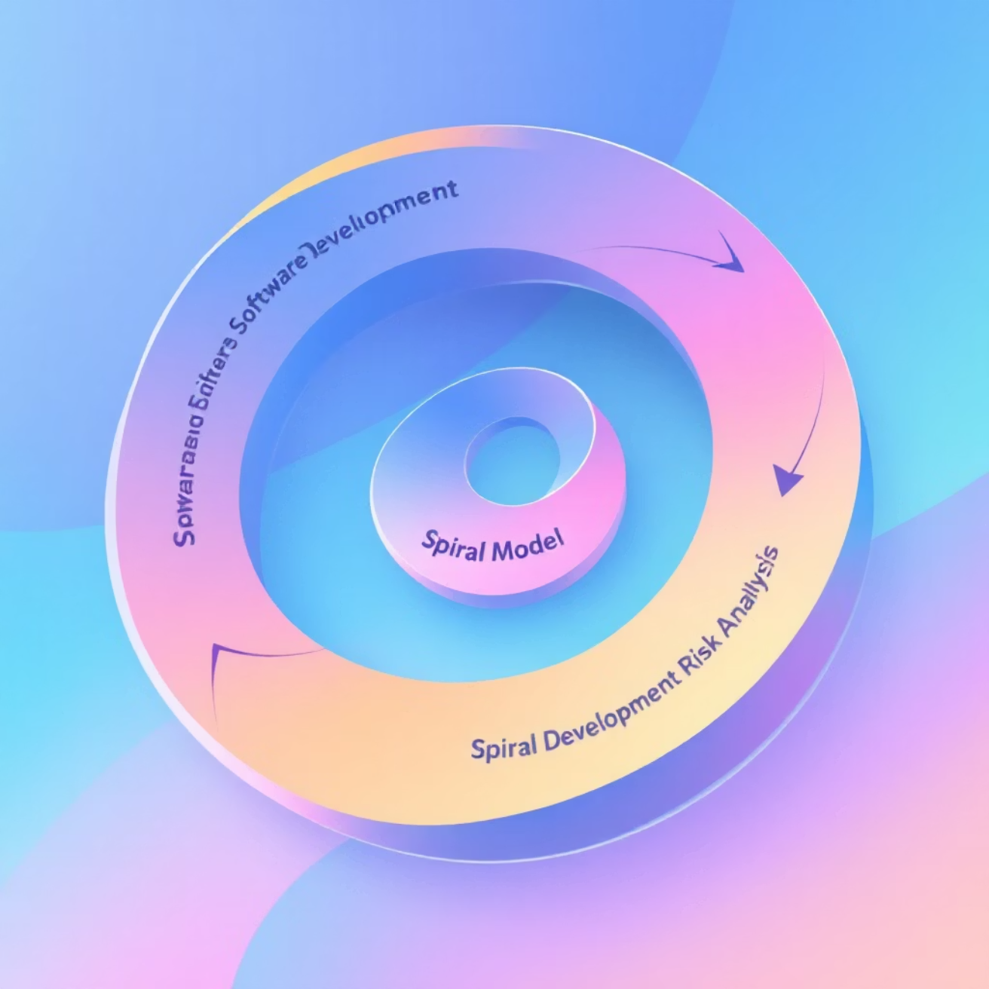

Spiral Model: Risk-Driven Development
Risk-Focused Approach
Combines iterative development with systematic risk analysis at each development cycle.
Advantages
Emphasis on risk reduction strategies
Highly adaptable to complex projects
Early prototype development
Limitations
Can be costly and complex to manage effectively, requiring specialized expertise.
Perfect for: Aerospace and defense software projects where safety requirements are paramount.

Slide 8

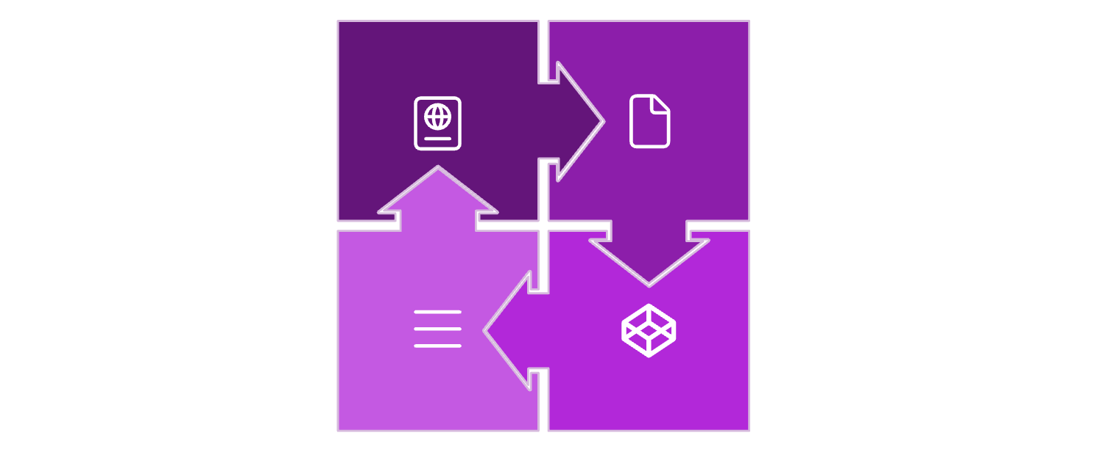




V-Model: Testing Focused Waterfall Variant
Requirements
Design
Validation
Implementation
Parallel Testing
Benefits & Drawbacks
Each development phase has a corresponding testing phase, ensuring comprehensive validation throughout the process.
Pros: Early test planning, clear validation stepsCons: Limited flexibility to accommodate changes
Industry Application
Essential for medical device software where regulatory compliance and rigorous validation are absolutely critical.

Slide 9
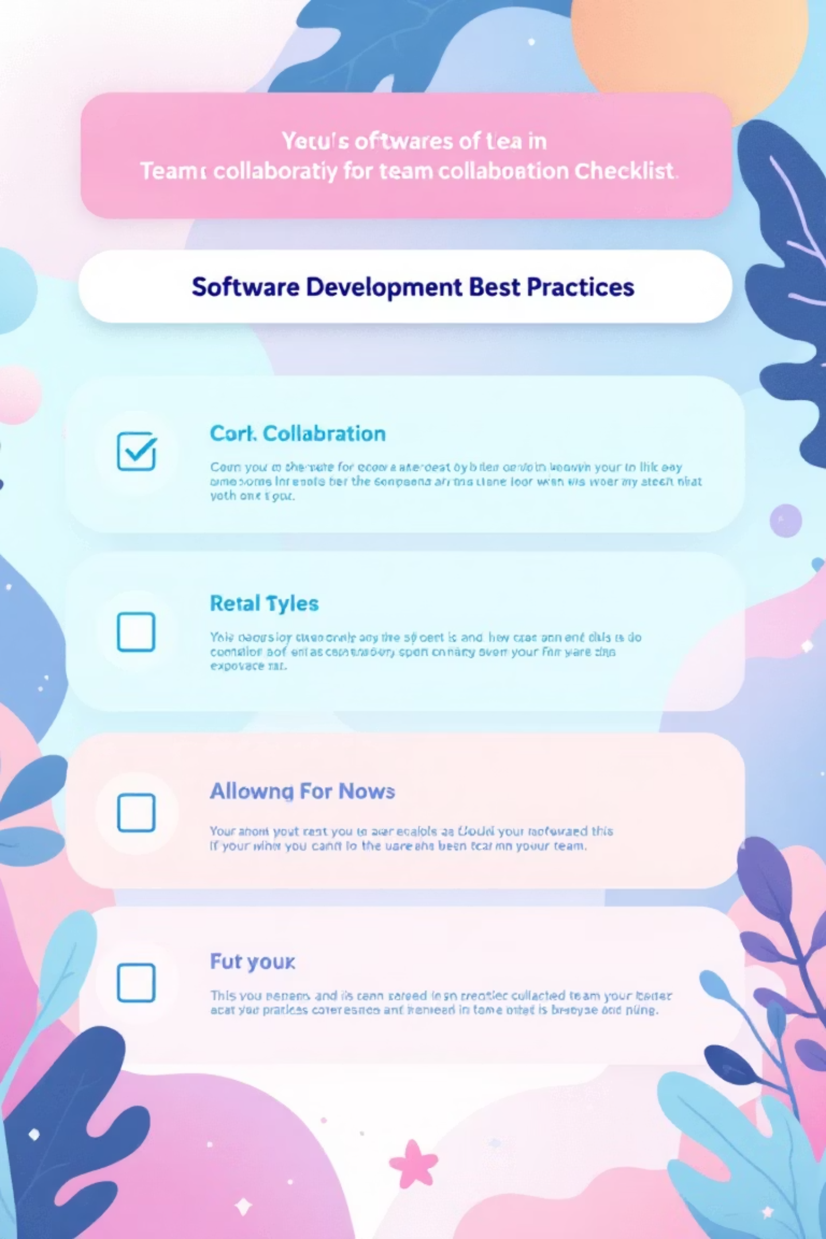




Best Practices for Successful SDLC Implementation
Stakeholder Engagement
Involve stakeholders early and maintain regular communication to clarify requirements and expectations throughout the project lifecycle.
Test Automation
Implement automated testing frameworks to catch defects early in development and significantly reduce manual testing effort.
Code Quality Control
Utilize version control systems and conduct thorough code reviews to maintain high code quality and team collaboration standards.
Continuous Monitoring
Monitor deployed software continuously for performance metrics, security vulnerabilities, and user experience optimization.
"Choose the SDLC model that aligns with your project's complexity, team capabilities, and organizational goals for optimal results."

Slide 10

Conclusion: Mastering SDLC for Software Success
Foundation of Excellence
Empowered Teams
Tailored Success
SDLC serves as the backbone of reliable, maintainable software development, providing structure and consistency.
Understanding models and phases empowers development teams to deliver maximum value efficiently and effectively.
Adopt proven best practices and customize your approach to meet your project's unique requirements and constraints.
Ready to build better software?
Start with a solid SDLC foundation today and transform your development process into a competitive advantage.

